Slide 1
Housing Market Future Pricing & Machine Learning
Isaac Becker, Alex Stephens, Kali Hullsiek, David Adurogbola, & Dan Sinda
Notes:
Dan

Slide 2
The Question & Prediction
Question: What are the future sales prices of houses? Which city will see the greatest increase in future sales prices of houses?
Prediction: Future price of homes in (King’s County) Seattle, WA will be on average greater than the future house prices of homes in Austin, TX.
Machine learning automates analytical model building. This project flowed through data ingestion with Pandas and Jupyter Notebook, data cleansed, explored data analysis with regression plots, and relied on libraries like Scikit Learning to conduct machine learning.
To test this prediction, advanced regression and data sources were gathered from Kaggle. This data provided information on date sold, sale price, number of bedrooms/bathrooms, square footage, lot size, number of floors, waterfront property, etc. to help build a model to predict the future sale price for each city.
Notes:
Dan

Slide 3
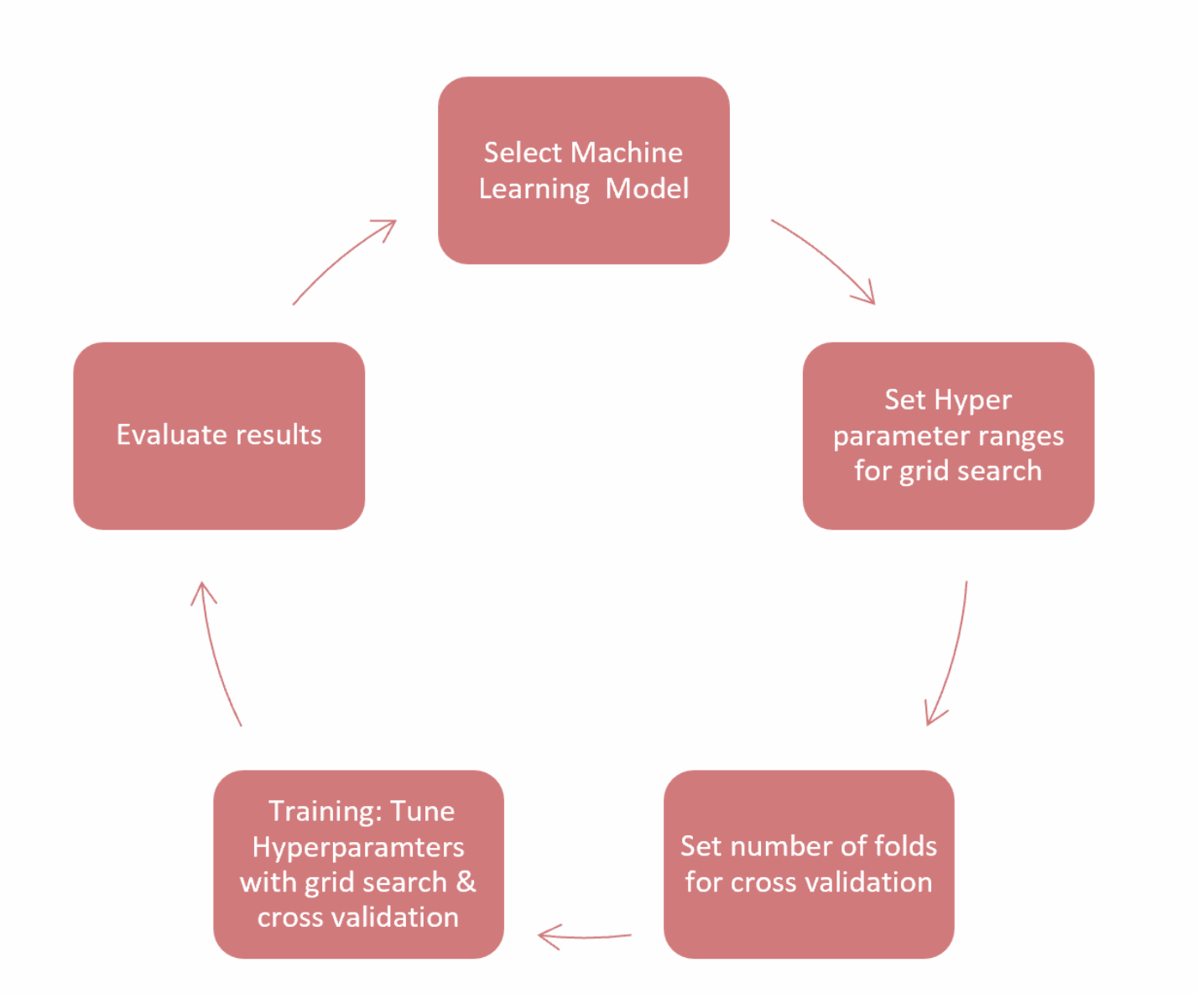
Data Resources & Methodology
Data Source:
Kaggle for Housing Market Data for Kings County (Seattle, WA) & Austin, TX.
Heroku-Voila-Jupyter Notebook
Libraries:
Python-Pandas - For handling structured data
Scikit Learn - For machine learning
Seaborn/Matplotlib - For regression and visualization
Notes:
Kali

Slide 4
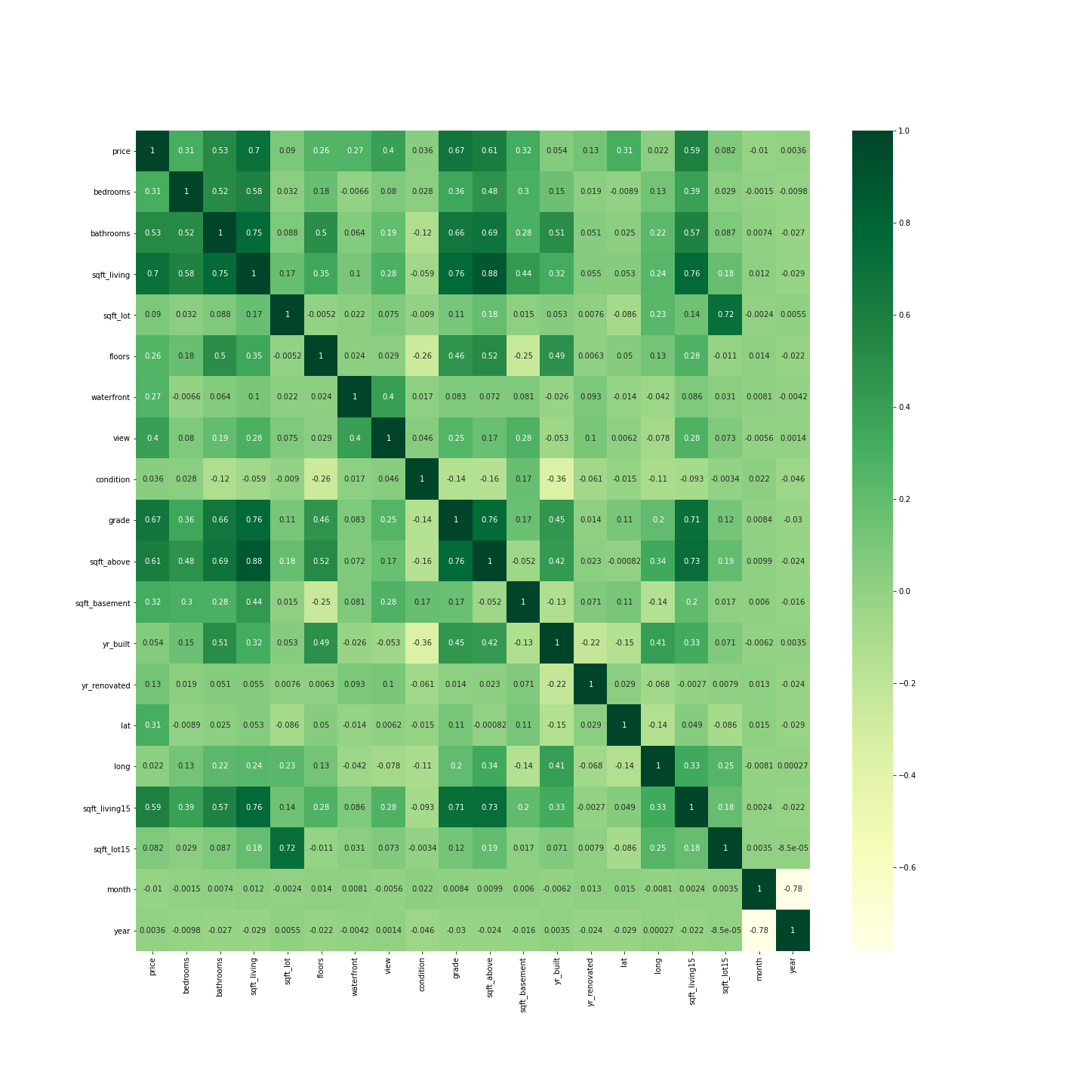
HeatMap Regression of Original Data
Shows correlation between different home factors such as # of rooms versus square footage and relates this back to price. According to data, square footage, # bathrooms, sq ft living but not lot, grade, most closely aligns with future home pricing.
Notes:
Kali

Slide 5
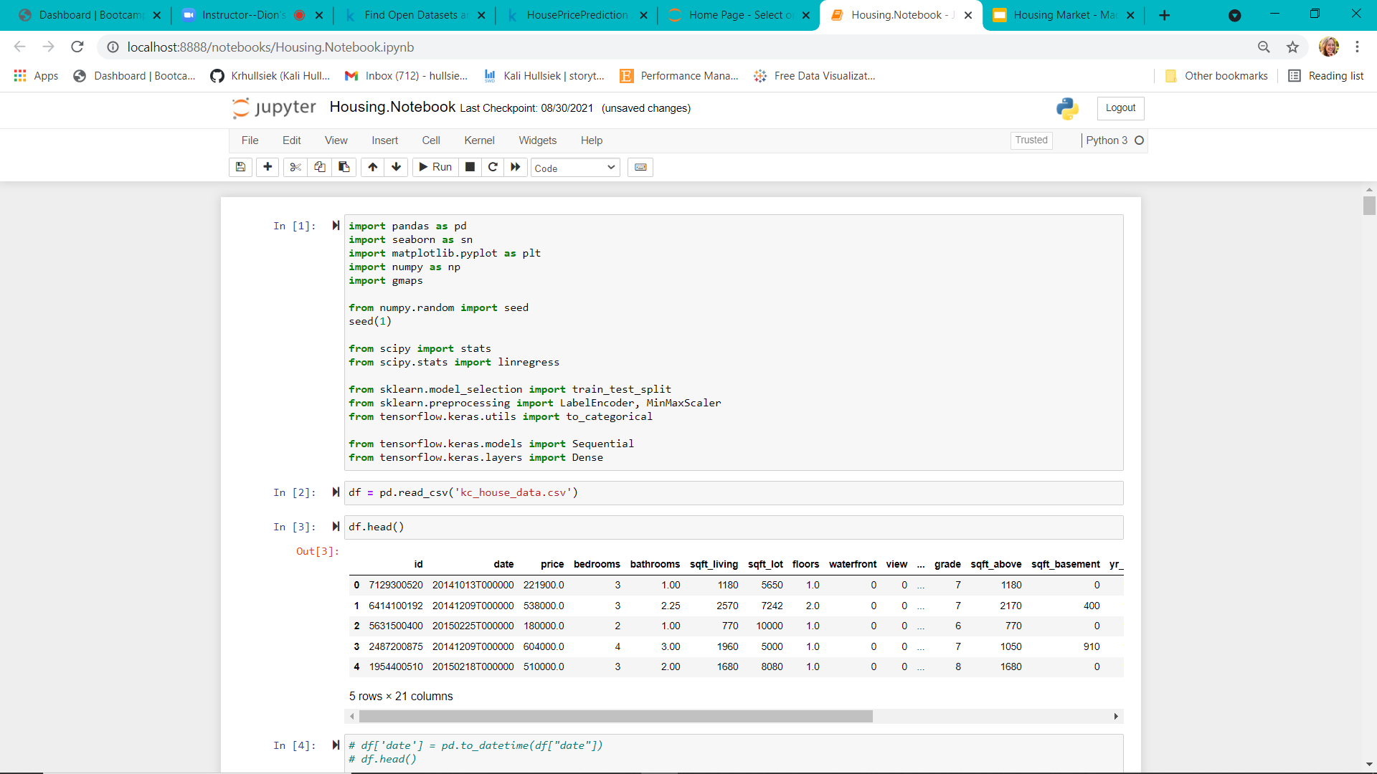
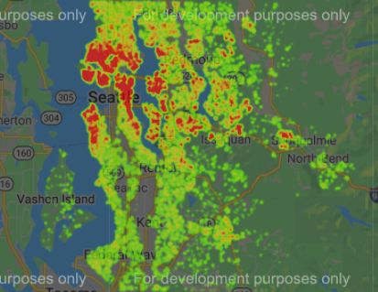
Heat Map of Predicted Home Pricing Part 1
Notes:
Kali

Slide 6
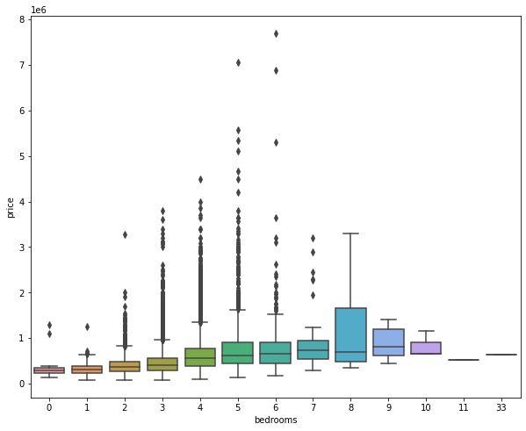
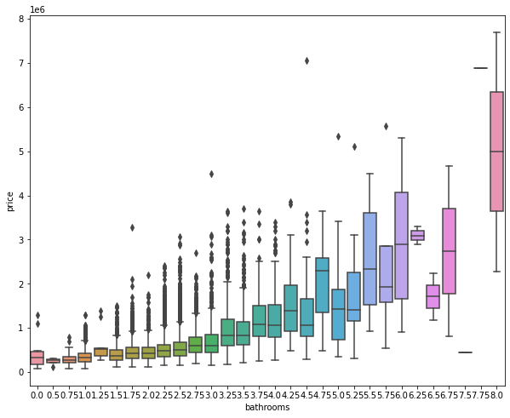
Visualization of Price Versus # of Bedrooms
Notes:
David

Slide 7
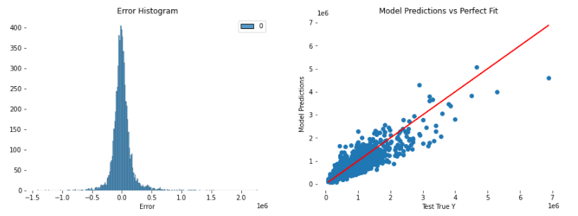
Regression of Predicted Home Pricing Part 2
Notes:
Bell curve showing relatively centered distribution.
David

Slide 8
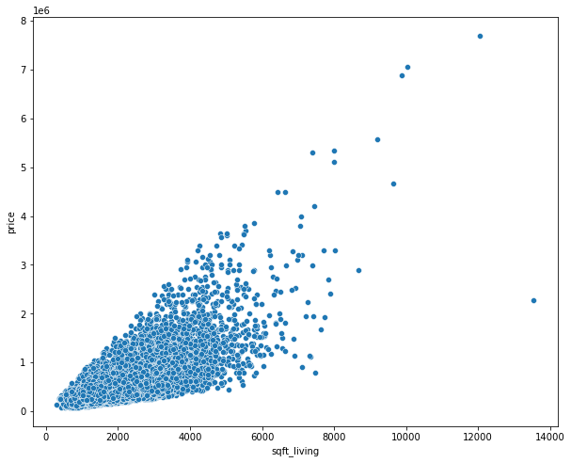
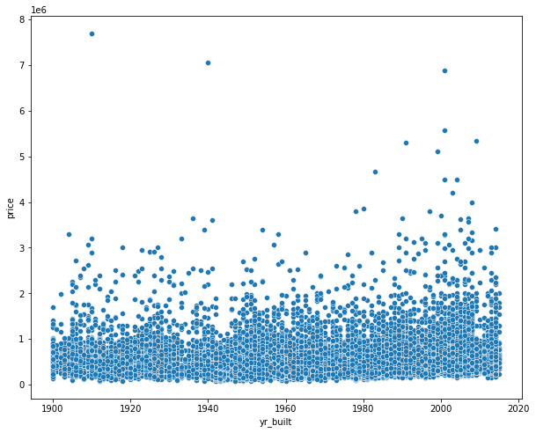
Scatter Plot of Price Versus Square Footage
Notes:
David

Slide 9
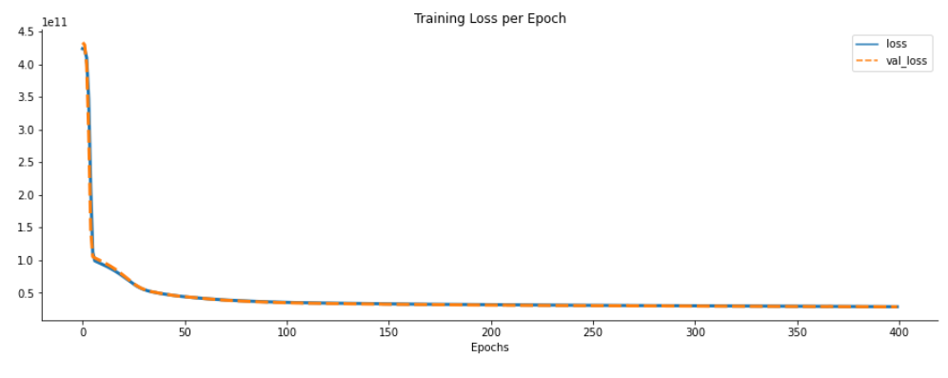
Plot of the Model Fit
Notes:
Shows that the model ran optimally with the loss value of the training data being depleted over time.
Isaac

Slide 10
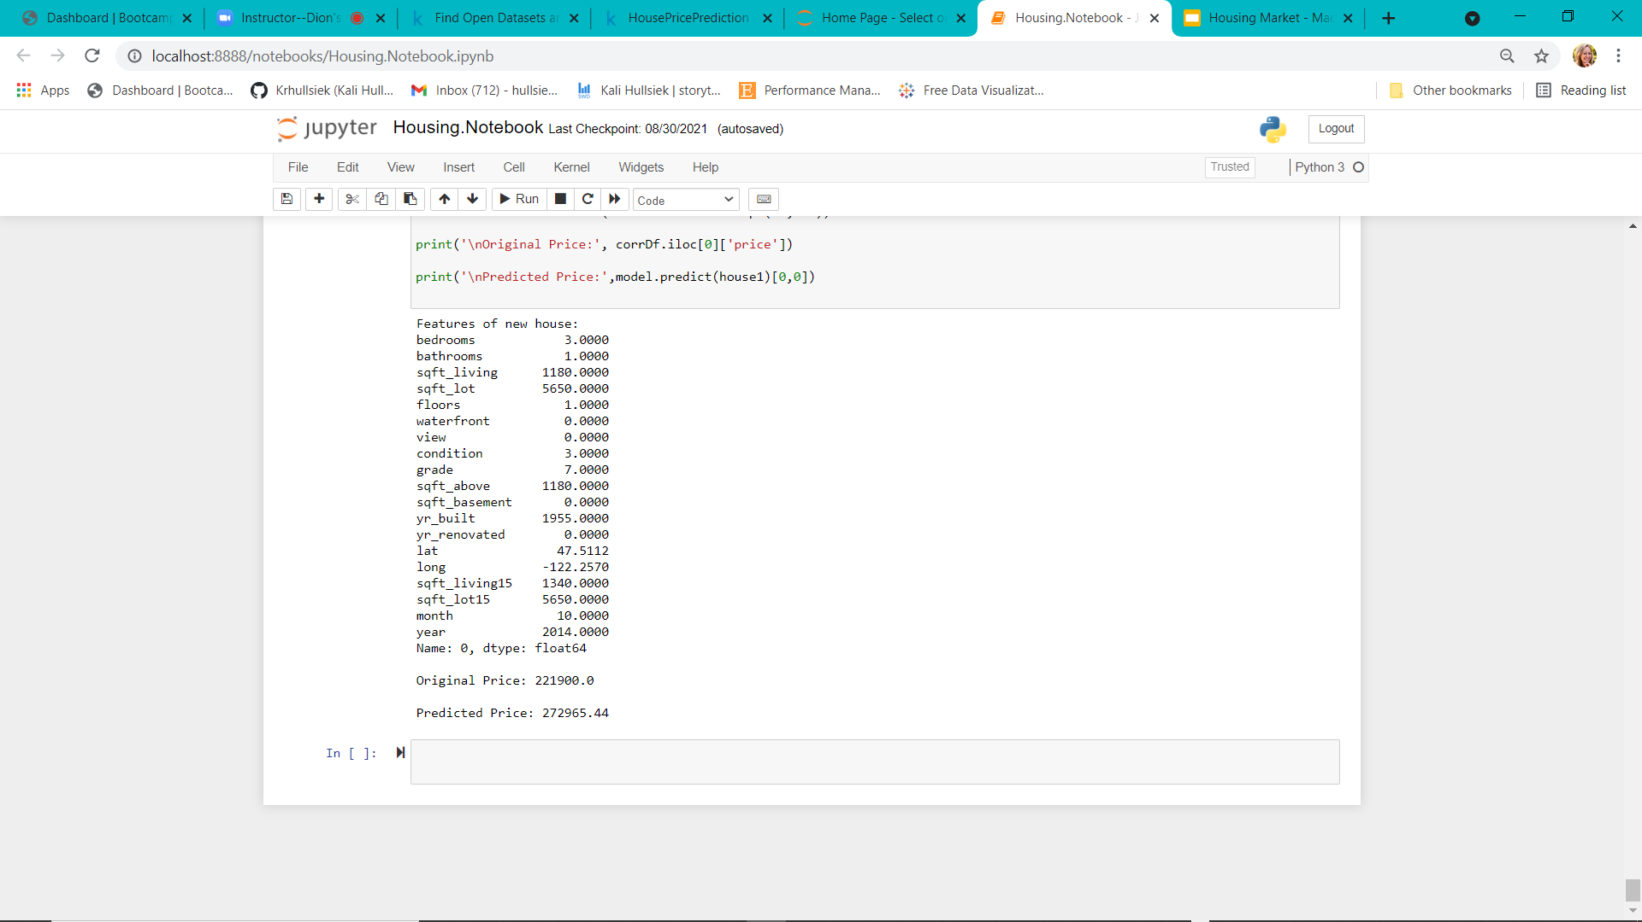
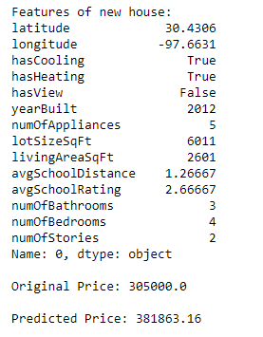
King’s County, WA
Austin, Texas
Notes:
Isaac

Slide 11
DEMO
Notes:
Alex

Slide 12
Analysis & Final Considerations
Seattle, WA:
Prediction $283, 705.44
Original: $221,900.00
Austin, Texas:
Prediction: $381,863.16
Original: $305,000
Prediction: Incorrect, Austin, TX has both an original and predicted home price higher than Kings County (Seattle, WA). Factors such as square footage and number of bedrooms/bathrooms are also greater.
Limitations: predictions for pricing - circumstantial evidence proves that it will not fluctuate as much for a machine learning prediction. Cannot account for unpredictable influences like systemic risks or, for example, market changes due to a pandemic.
Future Considerations: Look to AI and other automated machine learning functions to provide real-time updates based on most current information and feedback to mitigate discrepancies and risks.
Notes:
Mlfutureengineering.com
Isaac
Data Science Real Estate: great info on machine learning based projects

Slide 13
QUESTIONS?
Notes:
Isaac

